Slide 1
Motivation
Finding data

Slide 2




Placing Housing into a Public Health Framework
Reframing the Issue
Social, Physical and Legal Determinants of Health
A Public Health Issue
Root Causes of Violence
Data & Research
Law & Policy
Complicated issues <> innovative, advanced methods
Tools for Violence Prevention
Notes:
My focus is in exploring the social, physical and legal determinants as root causes of violence which includes interpersonal violence, intimate partner violence, and child victimization.
Housing is one of the social determinants that I focus on.

Slide 3
Mapping Segregation
Racial segregation in most major U.S. metropolitan areas is worse today than it was during Reconstruction. This did not happen by accident, nor did it happen overnight. The origins of segregation in the American city are deep and go far beyond the oft-cited quip that “birds of a feather flock together."
De jure versus de facto segregation: Segregation was created by federal housing policy and both overt and indirect racism throughout much of the 20th century
Reinforced today: The racial segregation that exists across today’s urban landscape that was actively produced in the 20th century continues to impact the health and well-being of residents today
Living Together / Living Apart (livingtogetherlivingapart.com)
Notes:
The United States' racially segregated urban landscape was actively produced in the 20th century and is continuously reproduced in the 21st.

Slide 4
Why does segregation persist today?
Gentrification integrates some groups while further segregating others (Hwang, Roberto and Rugh, 2019)
Causes and reinforces racial disparities in
Health
Education
Employment
Crime
Is caused in part by
Wealth stripping and unaffordable housing
Neighborhood segregation is reinforced by US housing policies and laws
Despite the rhetoric around equal rights (e.g., 14th A) and the eradication of discriminatory treatment by race (e.g. Brown, Civil Rights Act), the effects of segregation via housing policy continues to exert an effect on population health
Notes:
Many neighborhoods have been disinvested whereas others have undergone gentrification
This disproportionately impacts black and Latine residents results in loss of community consciousness, distinctness of character → ghettoization

Slide 5
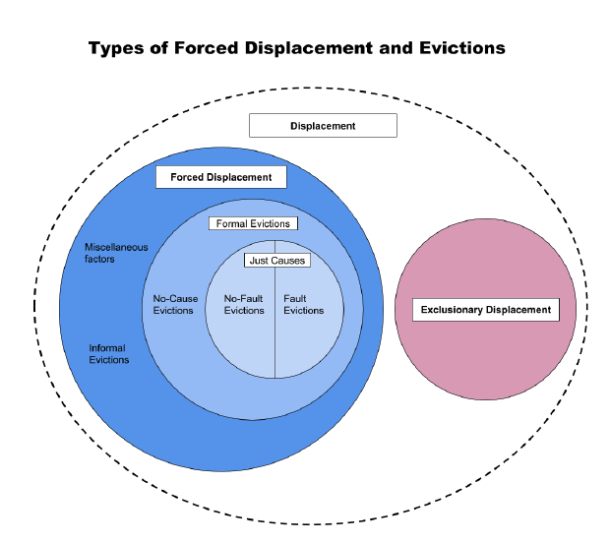
Why does segregation persist today?
Gentrification involves two distinct but overlapping components: an influx of affluent neighbors and the displacement of low-income neighbors.
Three characteristics
Downgrading and disinvestment resulting in neighborhood change
Displacement of working class
Transformation of housing stock
Notes:
A process of sociospatial differentiation

Slide 6
Law, Policy and Segregation
“Social policy is health policy”
Segregation is the spatial separation of people along any possible dimension of human difference
De Jure v De Facto Segregation
The Six Pillars of Segregation created by government (in)action
Restrictive Covenants
Discriminatory Real Estate Practices
Redlining
Zoning
Urban Renewal & Highway Construction
Violence & Victimization
Sources: Jewish Alliance for Law & Social Action;
The Color of Law by Richard Rothstein
Notes:
How is social policy, health policy?
In the example above, we frequently talk about the impact of living with a household member who has criminal justice involvement, but rarely mention the war on drugs.
Again, the policies must not be viewed in isolation but as systematic efforts to punish poor people who are primarily impacted.
For example, I do a lot of work around child welfare, and in some states child neglect is defined as the inability to provide the basic needs of your child because of food insecurity and/or incarceration.
So, child welfare policy is directly tied to the war on drugs and housing policy, because where you live determines whether you live in a food desert.
I urge you to think about why we continue to place the onus on individuals to address their ACEs instead of looking to change the policies undergirding them.
Similarly, neighborhood segregation is the product of both de jure and de facto segregation, the former being segregation that has been directly caused by federal law and policy
De jure segregation is state sponsored segregation whereas de facto segregation is segregation that is the result of personal preferences
With that, it is possible to describe the six pillars of segregation as follows:
Restrictive Covenants
Discriminatory Real Estate Practices
Redlining
Zoning
Urban Renewal & Highway Construction
Violence & Victimization

Slide 7
The Six Pillars
Past and present

Slide 8
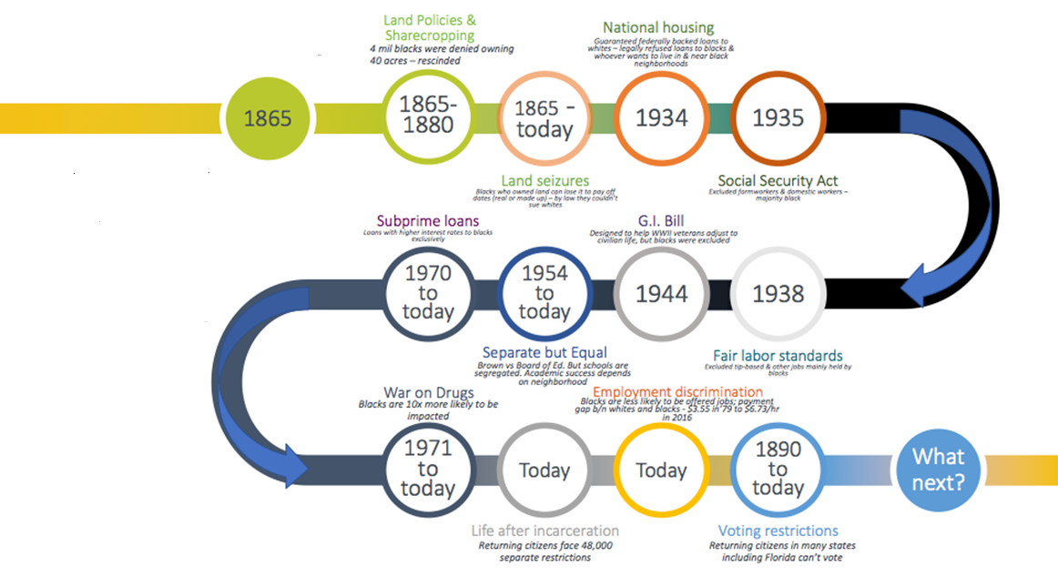
Linking Land & Housing Policies to the physical and social
determinants of health
Timeline of governmental policies related to housing insecurity since the Civil War Amendments (13th, 14th and 15th)
Notes:
We start with land policies and sharecropping in 1865, when federal law rescinded the promise to redistribute 400,000 acres of land as reparations to former slaves i.e., the promise of “40 acres and a mule”
African Americans resorted to renting the farmland in exchange for a “share” of the crop
From 1865 on land seizures were common for Black farmers who were in debt
1949-1970 governmental abuses of the power of eminent domain disproportionately impacted Black people
The National Housing Act of 1934 guaranteed federally-backed loans to whites and legally refused loans to anyone else who chose to live in or near Black neighborhoods.
This practice, known as “redlining,” targeted entire Black neighborhoods and identified them as “Grade D.”
This made it nearly impossible for appraisers in the private sector to do business in Black neighborhoods because all the residents were considered bad credit risks.
Since this legislation prevented blacks from receiving federally-backed home mortgages, whites usually purchased homes in black neighborhoods and then sold “housing contracts” to blacks who wanted to become homeowners, often for two or three times the amount of the mortgage.
These contracts only guaranteed black families the rights to the house AFTER all the payments were complete. Missing even one payment, or being late, would result in the black family losing their house immediately.
The G.I. Bill of 1944
This was enacted to help veterans adjust to civilian life by providing low-cost home mortgages, low-interest business loans, tuition assistance, and unemployment insurance. Unfortunately, Black veterans were excluded from many of these benefits.
Separate But Equal Doctrine
Although the “Separate but Equal” Doctrine was declared unconstitutional in 1954 (Brown vs. Board of Education), American schools are more racially segregated today than at any other time in the past four decades.
Because schools are tax funded, where you live determines the quality of the school you attend. Black students are five times as likely to live in an area of concentrated poverty, with underfunded, understaffed, and overcrowded schools.
Subprime Loans
Starting in the 1970s subprime loans (loans with higher interest rates) were issued almost exclusively to Black families —regardless of a family’s income, education, or good credit history creating housing insecuiry through foreclosure and stripping wealth in black communities
As a result, Blacks continue to unfairly pay more for homes of the same value as their white counterparts.
This increases foreclosure rates in Black neighborhoods, and foreclosures are related to higher crime rates and poor community health.
Closely related is predatory lending practices in which overinflated loans are disproportionately given to people in low income communities of color
The War on Drugs
The War on Drugs, initiated in 1971 and continuing today, widened the racial wealth gap with policies targeting Black and Brown communities.
Although rates of using and selling drugs are comparable across racial lines, Blacks are up to 10 times as likely to be stopped, searched, arrested, prosecuted, convicted, and/or incarcerated for drug violations as whites.
Since this means that Black families are up to 10 times as likely to have a family member sent to prison, they are more than 10 times as likely to fall into hunger because of incarceration.
Life after incarceration and the War on drugs
When people are released from jail or prison, they are hoping for a second chance but there are a number of collateral consequences such as ineligibility to vote, get federal financial aid, licensing and even SNAP benefits

Slide 9
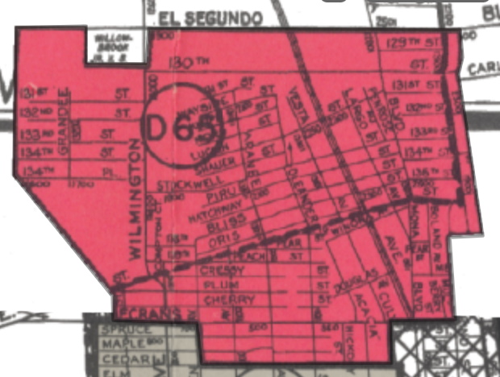
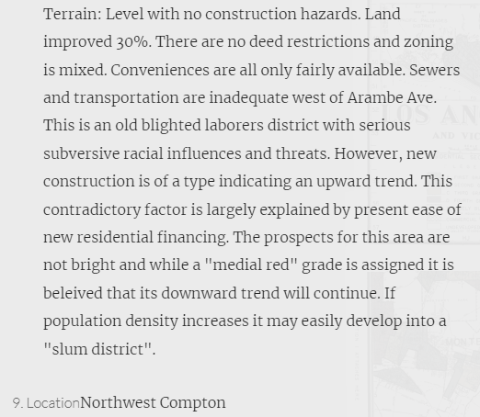
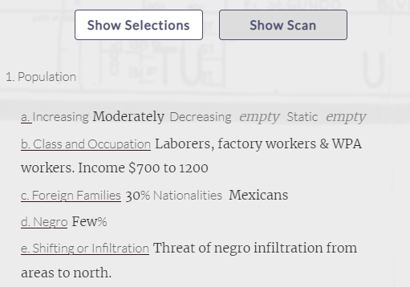
Redlining → Mapping Inequality (richmond.edu)
Notes:
Above is an example of a description given to NW Compton in which prospects for this area were deemed to be quote ‘not bright’ and provided that the area may develop into a slum due to the quote “threat of negro infiltration” from areas to the north
Redlining practices both reduced homeownership and inhibited the transfer of Intergenerational wealth in low income communities and communities of color.
The wealth of a community is associated with things that are in turn associated with violence, such as clean air, pure water, playgrounds, safe streets, good schools, healthy food, and public transportation.

Slide 10
Discriminatory Real Estate Practices (Rental Applications)
(a) If a landlord uses rental history or credit history as criteria in consideration of an application, the landlord shall not consider any rental history or credit history beyond seven years immediately preceding the date of the application, and the landlord must comply with subsections (1)(c) and (1)(d) of this section.
(b) If a landlord uses criminal history as a criterion in consideration of an application, the landlord shall not consider an arrest record of a prospective tenant from any time or any conviction of a prospective tenant that occurred more than five years before the date of the application; except that a landlord may consider any criminal conviction record or deferred judgment relating to:
46 Rental/Property Management Firms located in Colorado covering 1,043 properties
There was a lot of variability in number of properties impacted
Mean = 22.67, stdev = 45.84; median = 7.5
Type of Violation
The most common violation was to ask about criminal history without regard to the law (38-12-904(1)(b))
The next most common violation was to ask about rental history beyond the period specified in (38-12-904(1)(1))
More difficult to detect fee violations under 38-12-903

Slide 11
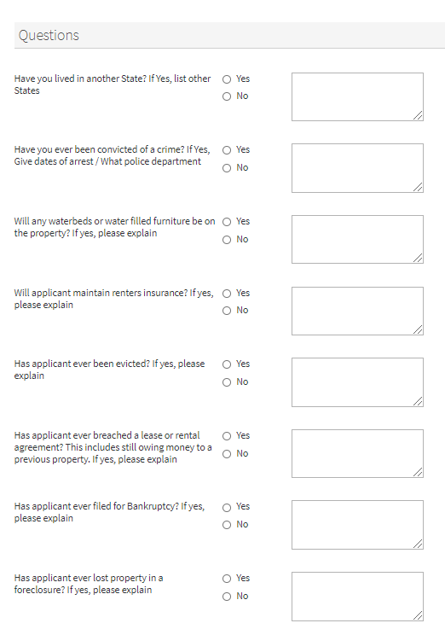
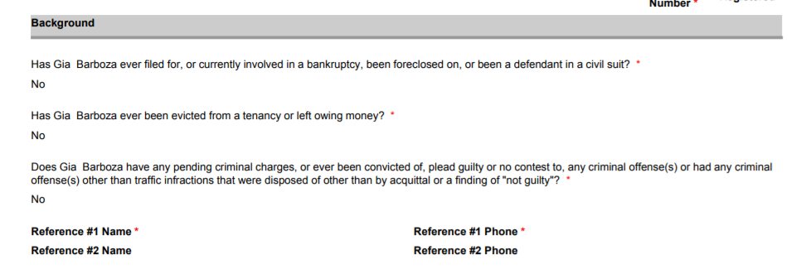
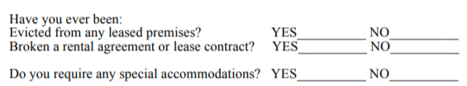
Example Violations

Slide 12
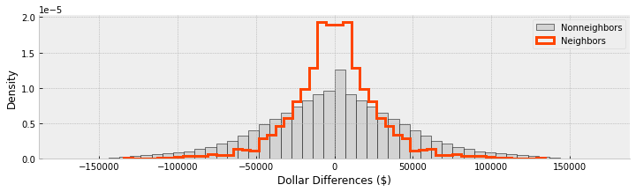
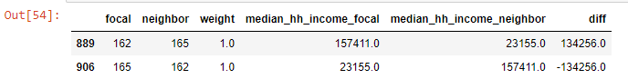
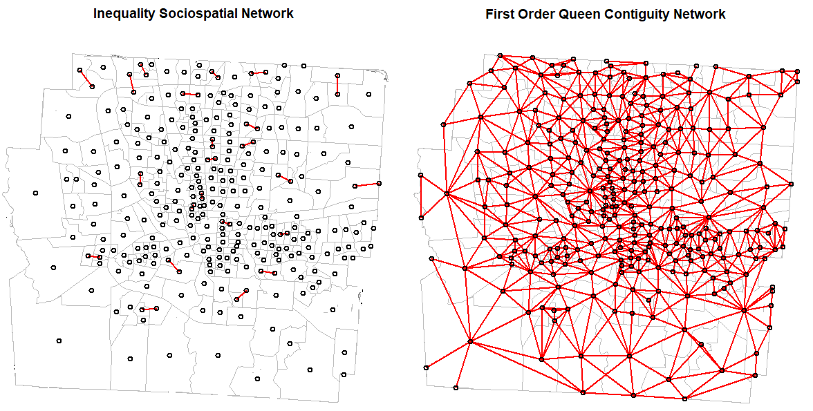
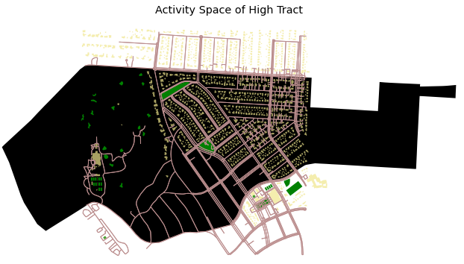
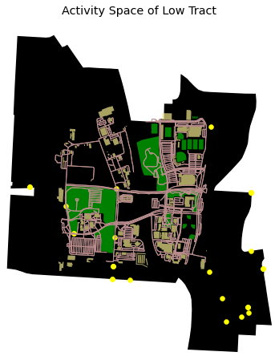
Sociospatial Weights & Latent Discontinuities
Examine the statistical distribution of income differences between neighboring and non-neighboring tracts
Create links between tracts with income differences that exceed some cutoff
A
B
D
Examine the geographic distribution of income differences between tracts
Map activity spaces for adjacent tracts characterized by extreme levels of income inequality
Economic Inequality: Assessing abrupt changes in income between neighbors
https://geographicdata.science/book/intro.html

Slide 13
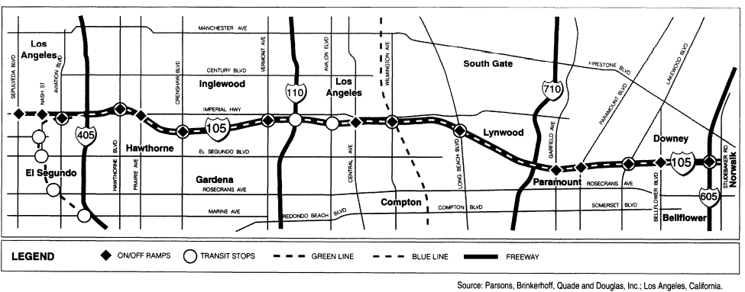
Urban Renewal & Highway Construction: A freeway “that has a heart”
Notes:
In Compton, the construction of the century freeway was responsible for residents losing their homes to freeway construction. In 1972 residents of the city of Compton filed a lawsuit because the construction of the century freeway was responsible for them losing their homes. The state Dept. of Transportation and the Federal Highway Administration agreed to reduce the width of the freeway and set aside highway money to build about 4,000 units of affordable housing to replace the low-income housing lost in the construction of the freeway (almost 9000 units were destroyed). Fighting over how the public money should be spent was still ongoing in 1997 more than 25 years after the original class action lawsuit was filed.

Slide 14
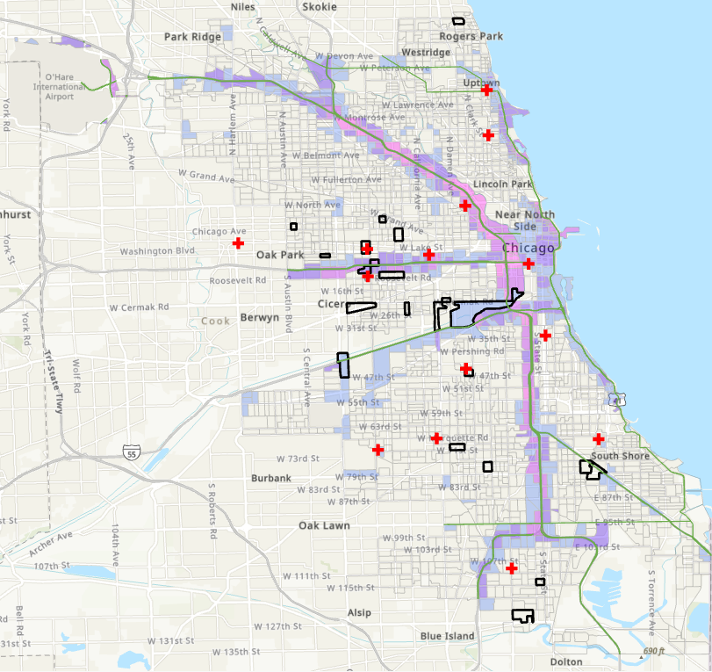
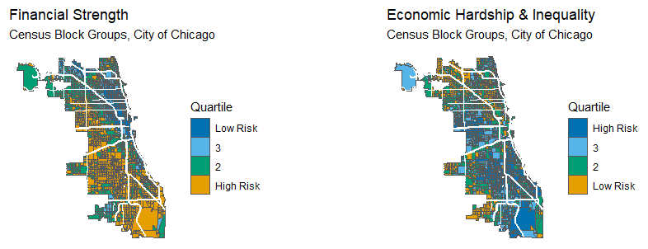
Linking Highways to Health
Census tracts with the most
overlapping deaths during 2020-2021 in Chicago in proximity to traffic volume
and major highways
Notes:
Compton is not the only place where residents living in proximity to highways suffer.

Slide 15
Reverse Redlining & Predatory Lending
While redlining denied people of color loans and mortgages in more desirable, predominantly White communities, reverse redlining defrauded residents ‘within certain geographic boundaries, often based on income, race, or ethnicity into accepting loans on unfair terms
Few analyses focus on the role that reverse redlining has had on increasing the wealth gap between whites and non-whites
The most significant redlining practices involved the overinflation of municipal property values to mortgage loan amounts
In 2006 (just before the foreclosure crisis), roughly one out of every two loans made to African American (50%) and Latine (46%) borrowers were high cost, compared to fewer than one out of five loans made to white borrowers (18%) (Ben, Ellen, and Madar 2019).
Further, overinflated loan-to-value ratios are the single most important factor leading to default and/or foreclosure (Quercia and Stegman 1992).
Notes:
The systematic channeling of otherwise qualified borrowers of color into subprime mortgages carrying high costs and risks was one form of reverse redlining (Squires, 2005).

Slide 16
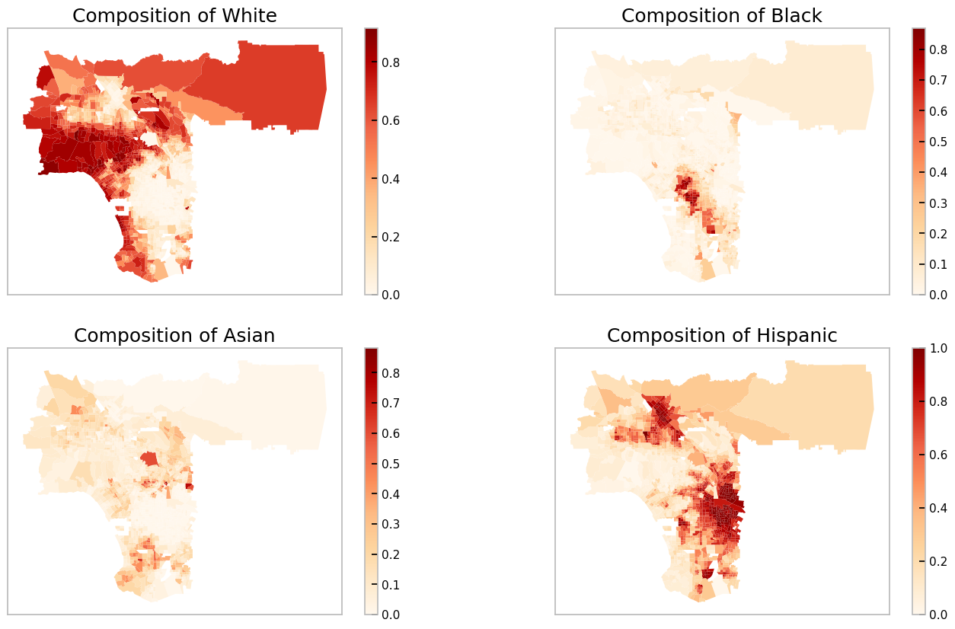
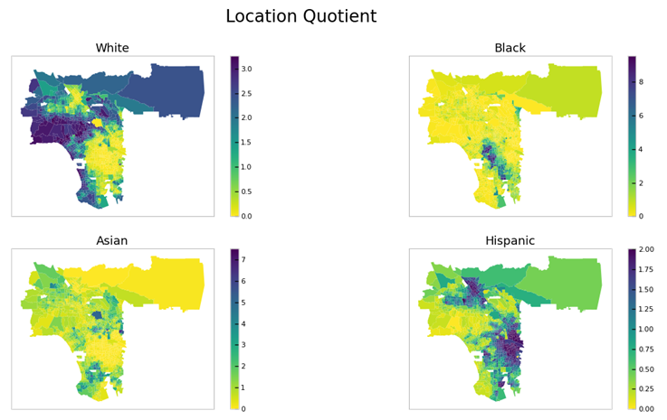
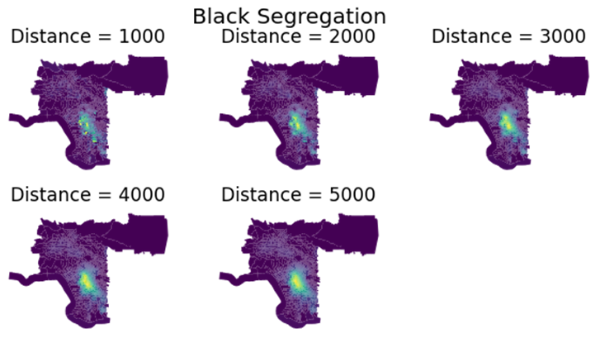
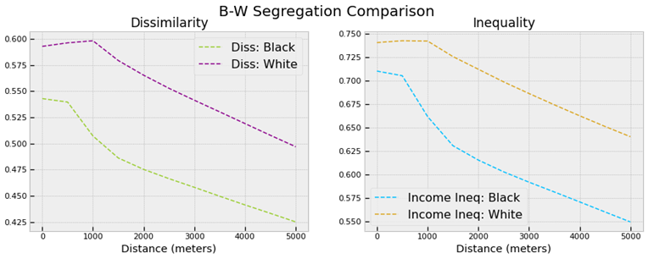
Does Segregation Exist? At what spatial scale?
Notes:
The location quotient (LQ) is like a hot spot relative risk. An LQ of 8 for the map labeled ‘Black’ suggests that the concentration of Black people into the central areas of the MSA is 8 times the global rate (overall concentration of the Black population in the MSA). This type of concentration is not observed for Latine or White people.
In this case, comparing the two profiles for Non-Latine Black and White groups suggests that the role of travel infrastructure on the experience and measurement of segregation is to help insulate segregation at larger distances.

Slide 17
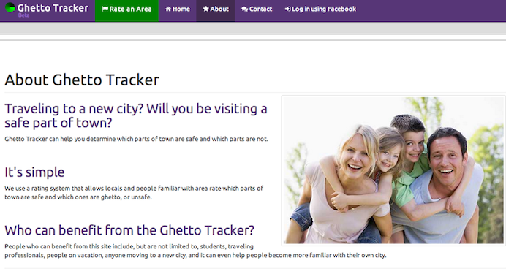
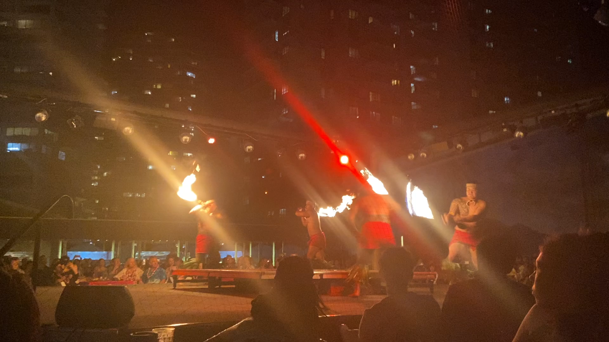
New mechanisms producing sociospatial segregation

Slide 18




Slide 19
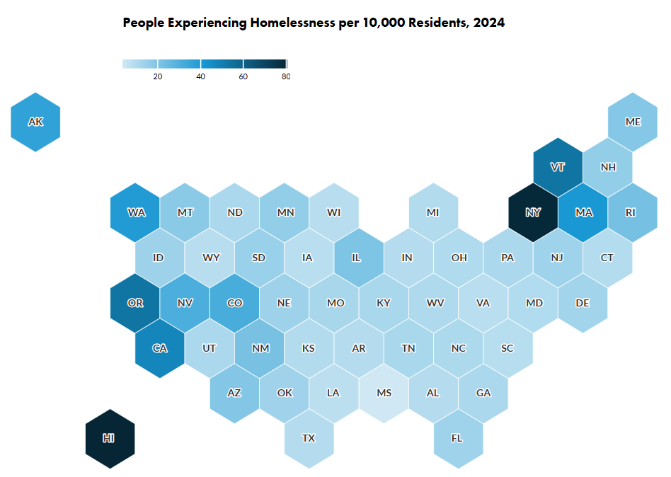
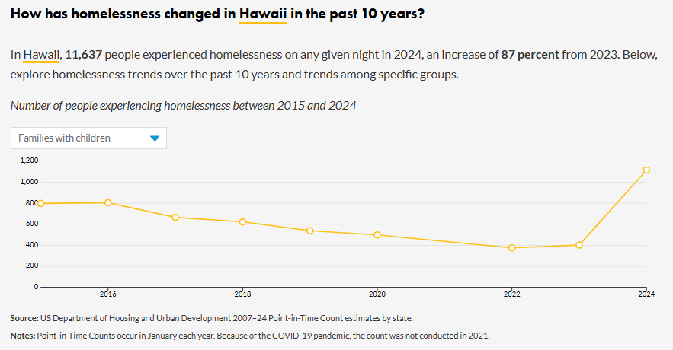
Homelessness and Housing Program Trends by State | Urban Institute
Notes:
According to an analysis by Honolulu’s Medical Examiner, the unsheltered homeless population is significantly more likely to experience premature mortality from drug use, infectious diseases and homicide.

Slide 20
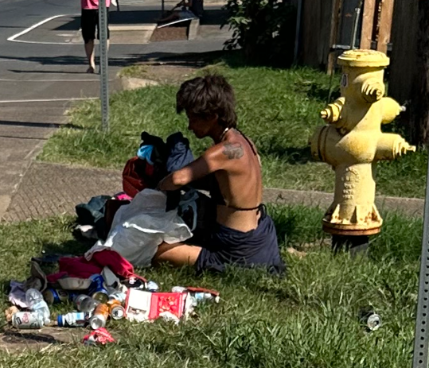
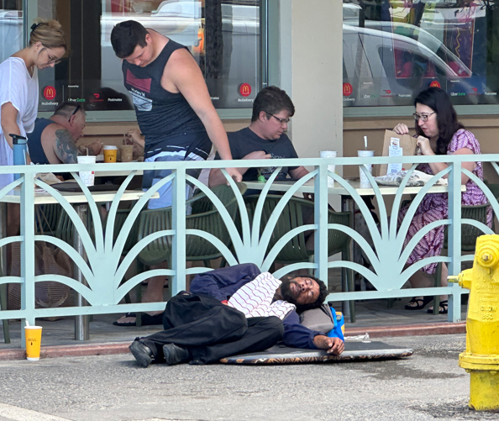

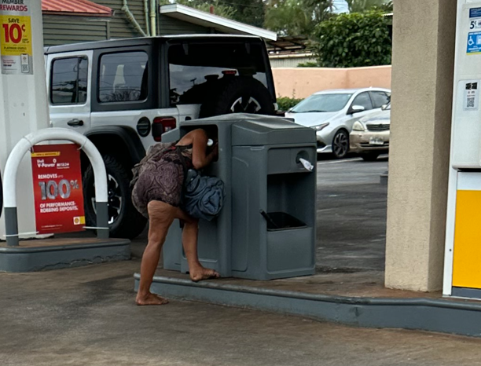
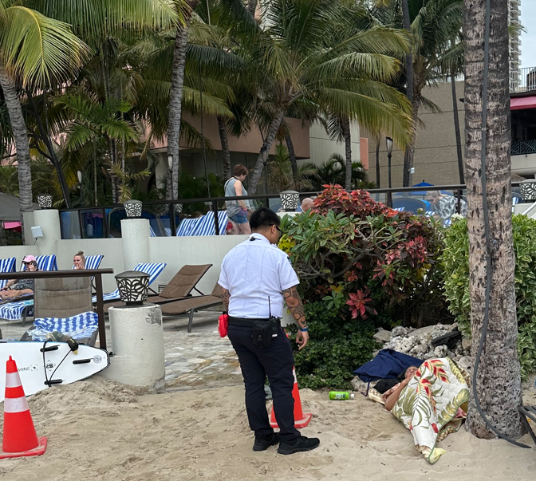

Slide 21
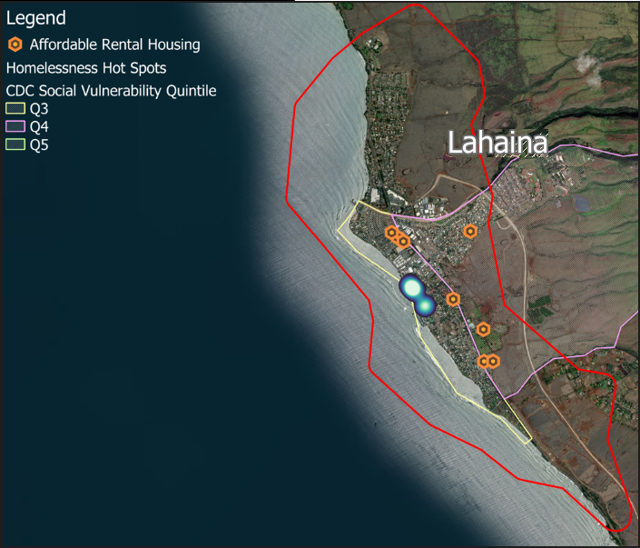
Lahaina Fire - Overview — VEDA Dashboard
SVI Data & Documentation Download | Place and Health - Geospatial Research, Analysis, and Services Program (GRASP) | ATSDR
My geocoding the unsheltered population

Slide 22
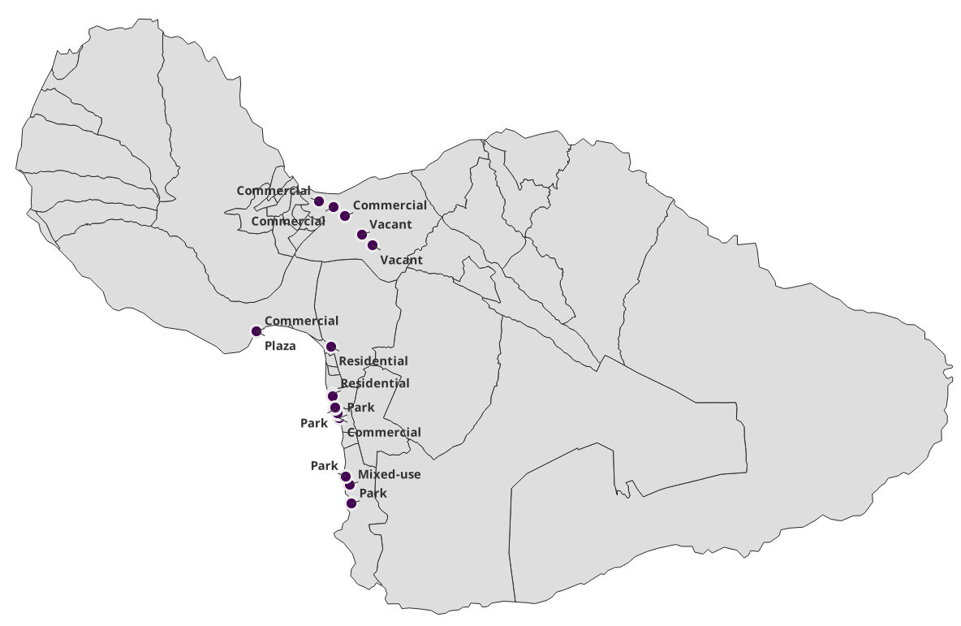
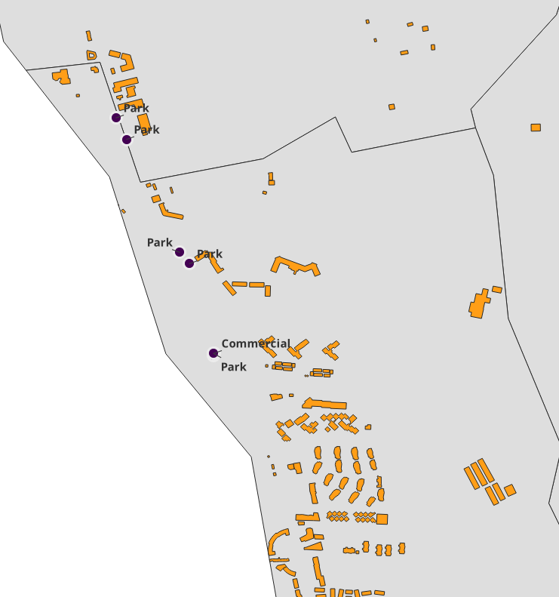
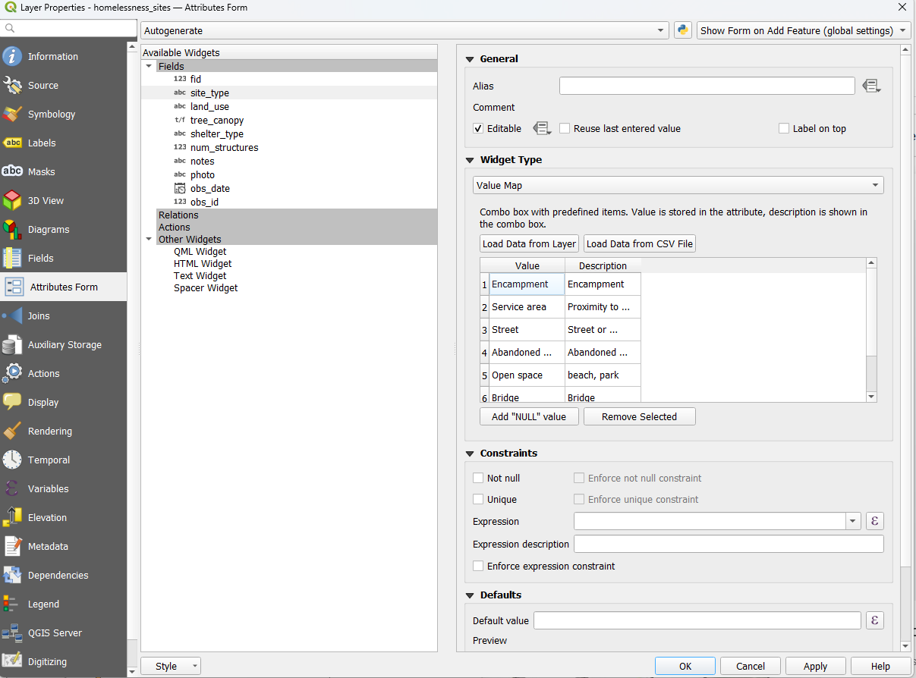

QField

Slide 23
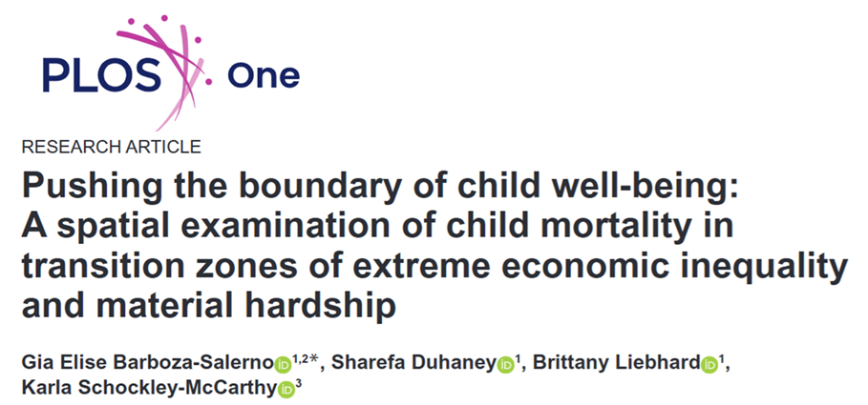
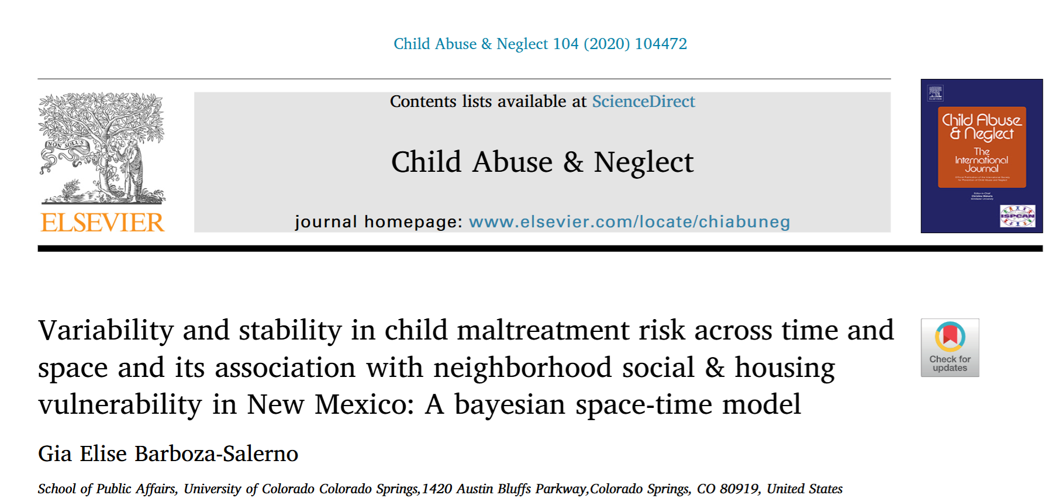
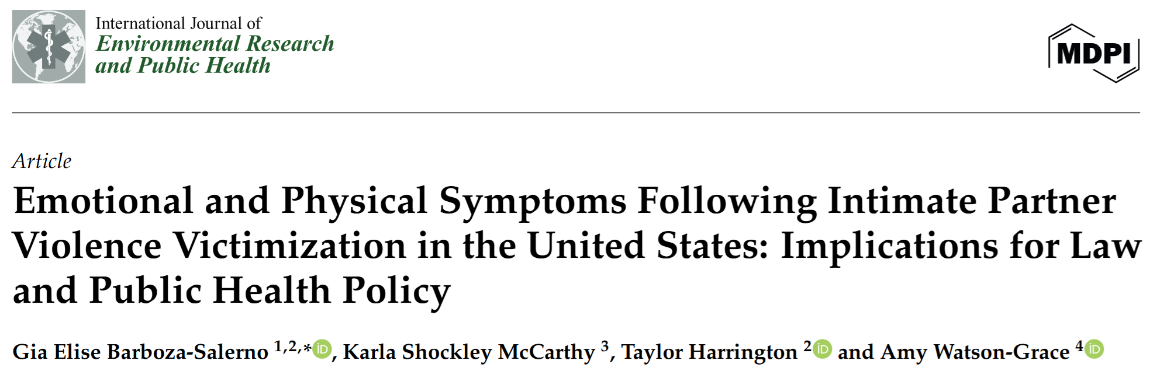
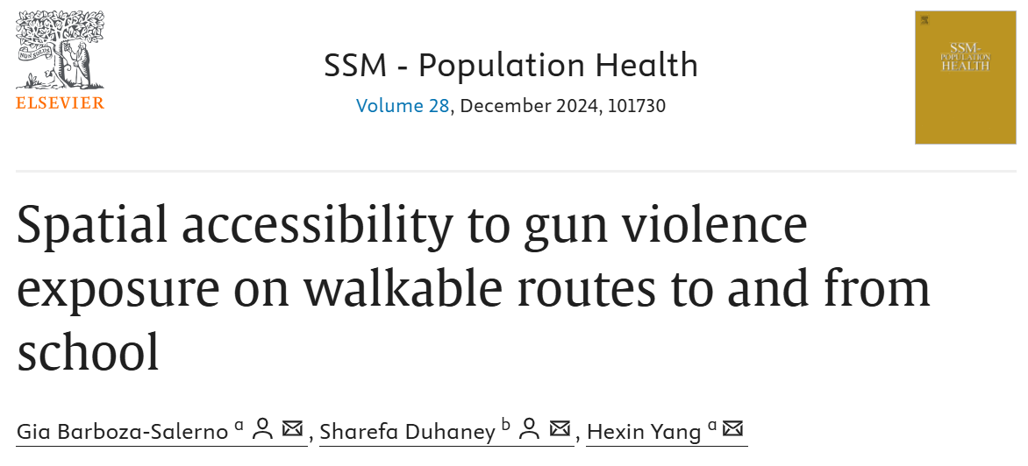
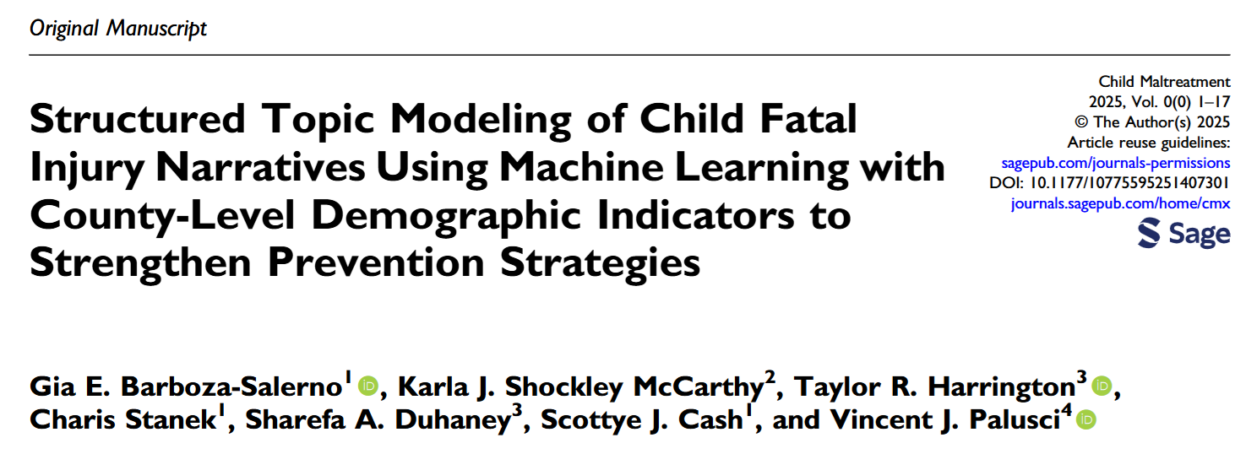
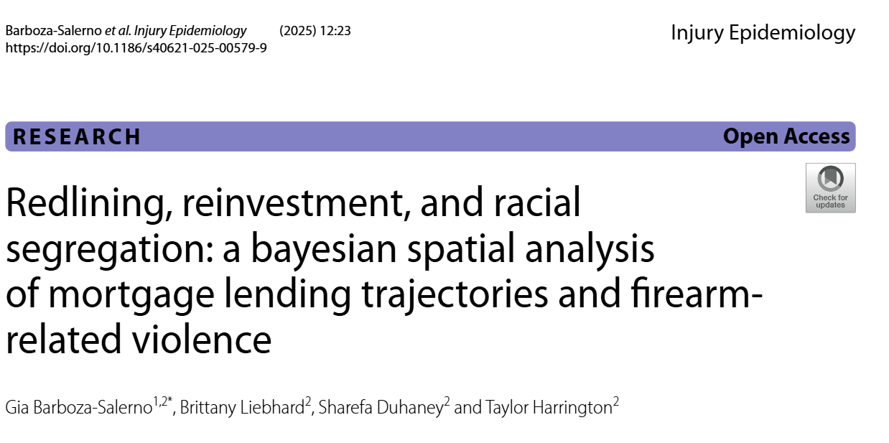

Slide 24
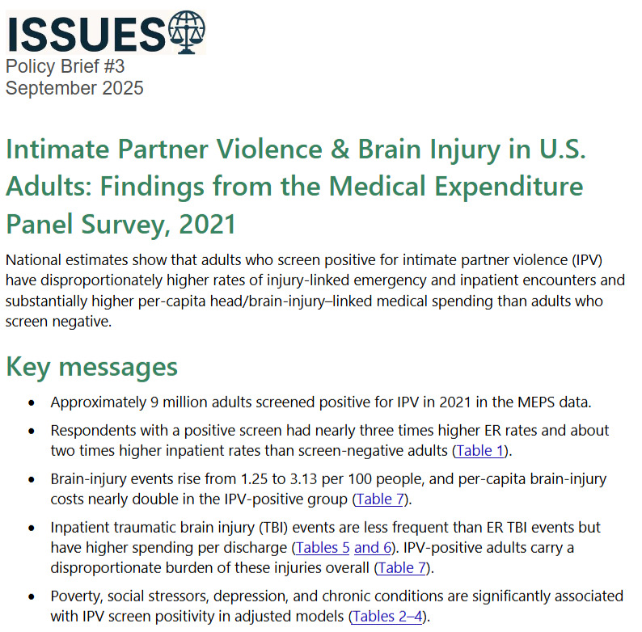
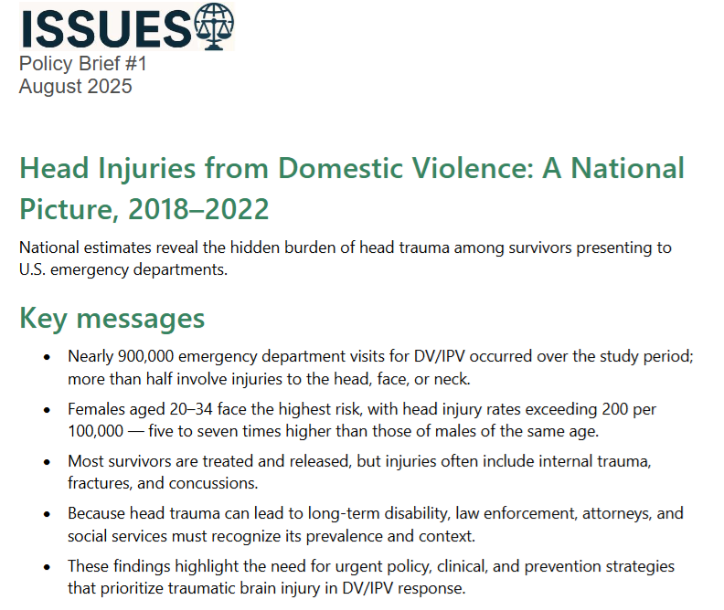
ISSUES Lab | ISSUES | The Ohio State University

